Slide 1
STUDENT MANAGEMENT SYSTEM
Project Done By
Deepali C Chavan

Slide 2
Tools Required
Front-End:Angular
Back-End:SpringBoot

Slide 3
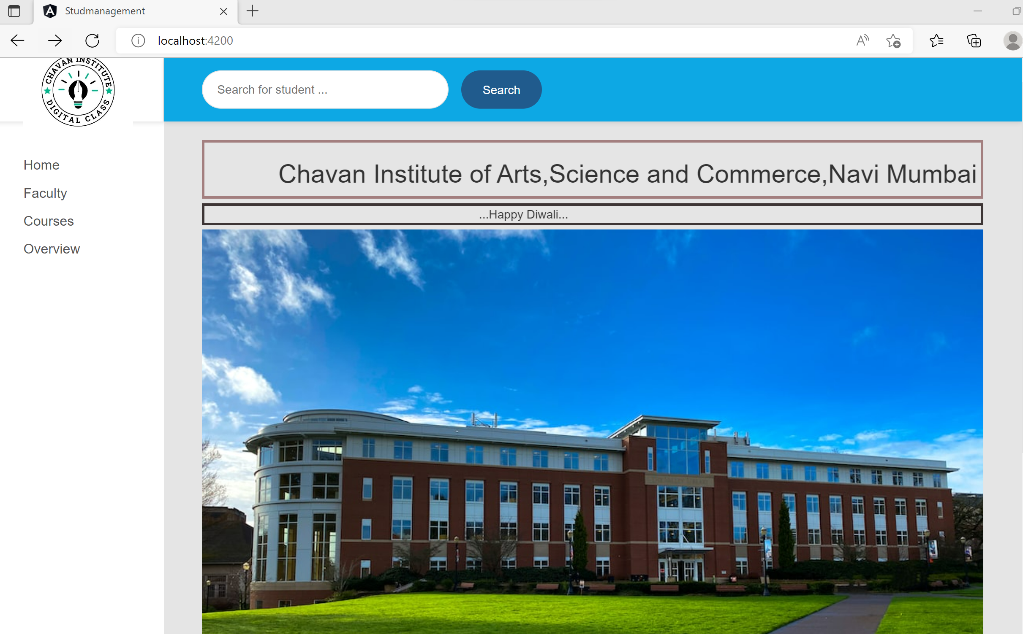
WELCOME PAGE

Slide 4
CRUD OPERATIONS:
CREATE(ADD STUDENT DATA)

Slide 5
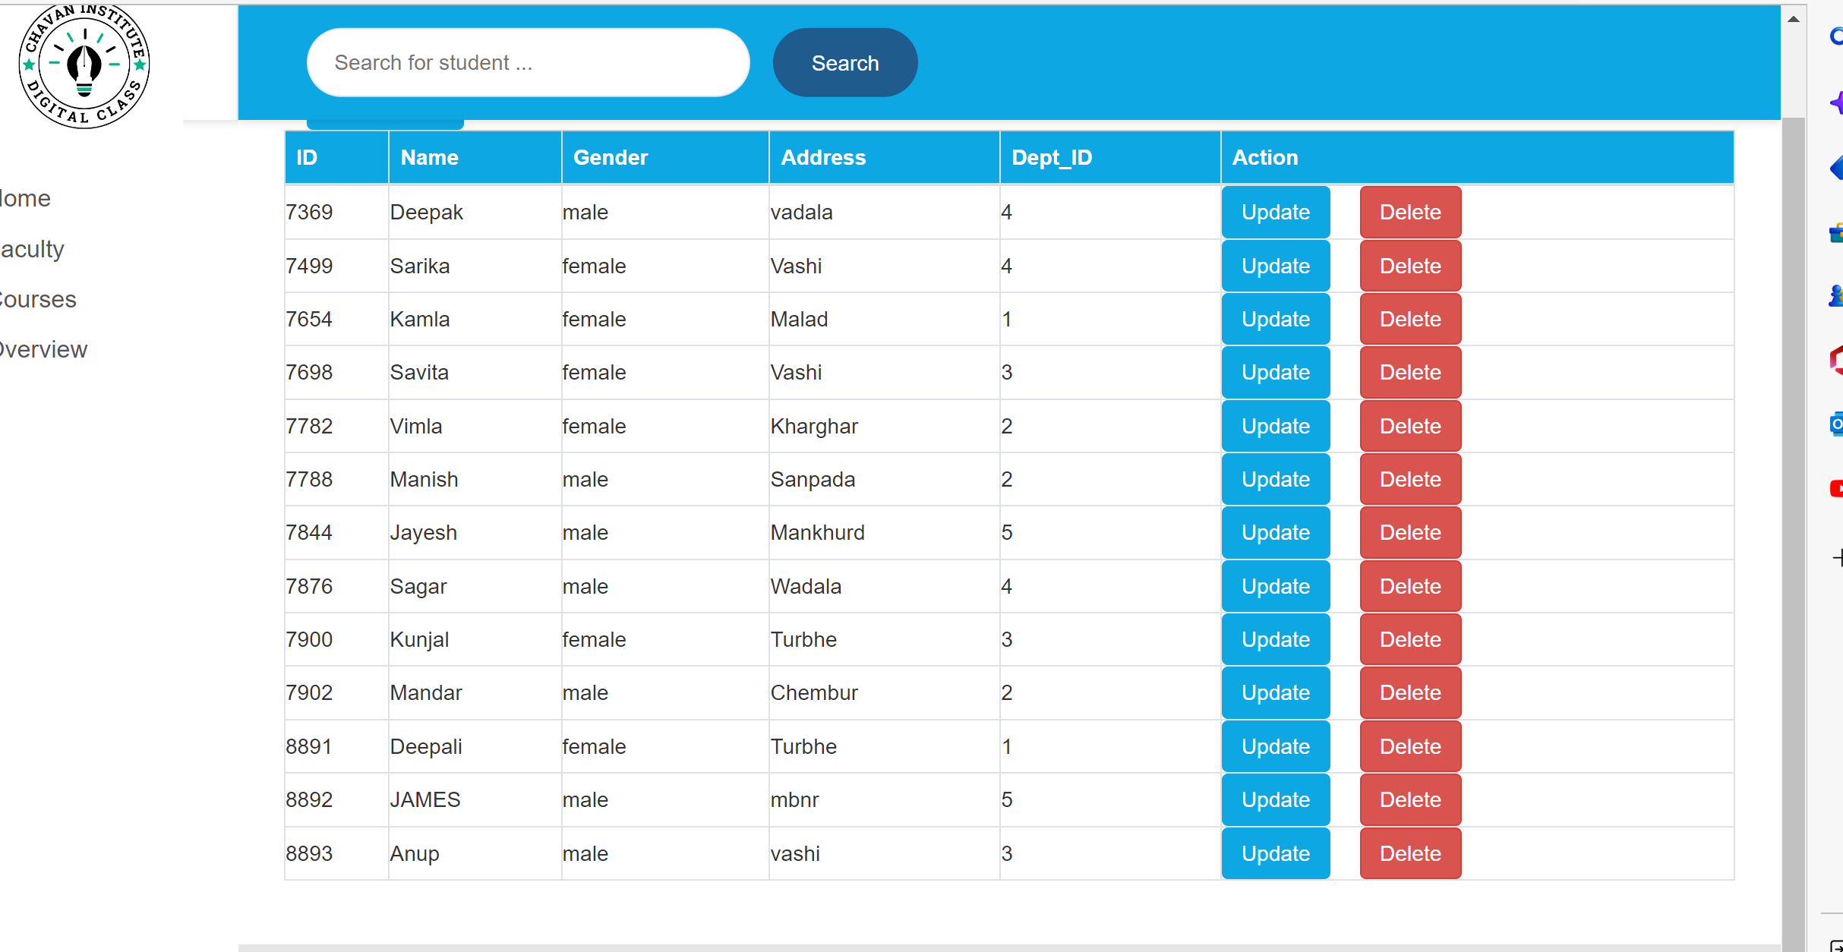
BEFORE ADDING ARCHANA DATA

Slide 6
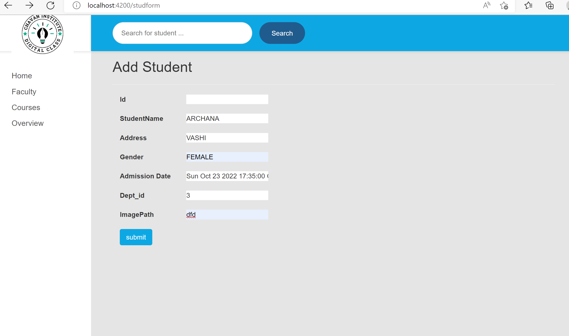

Slide 7
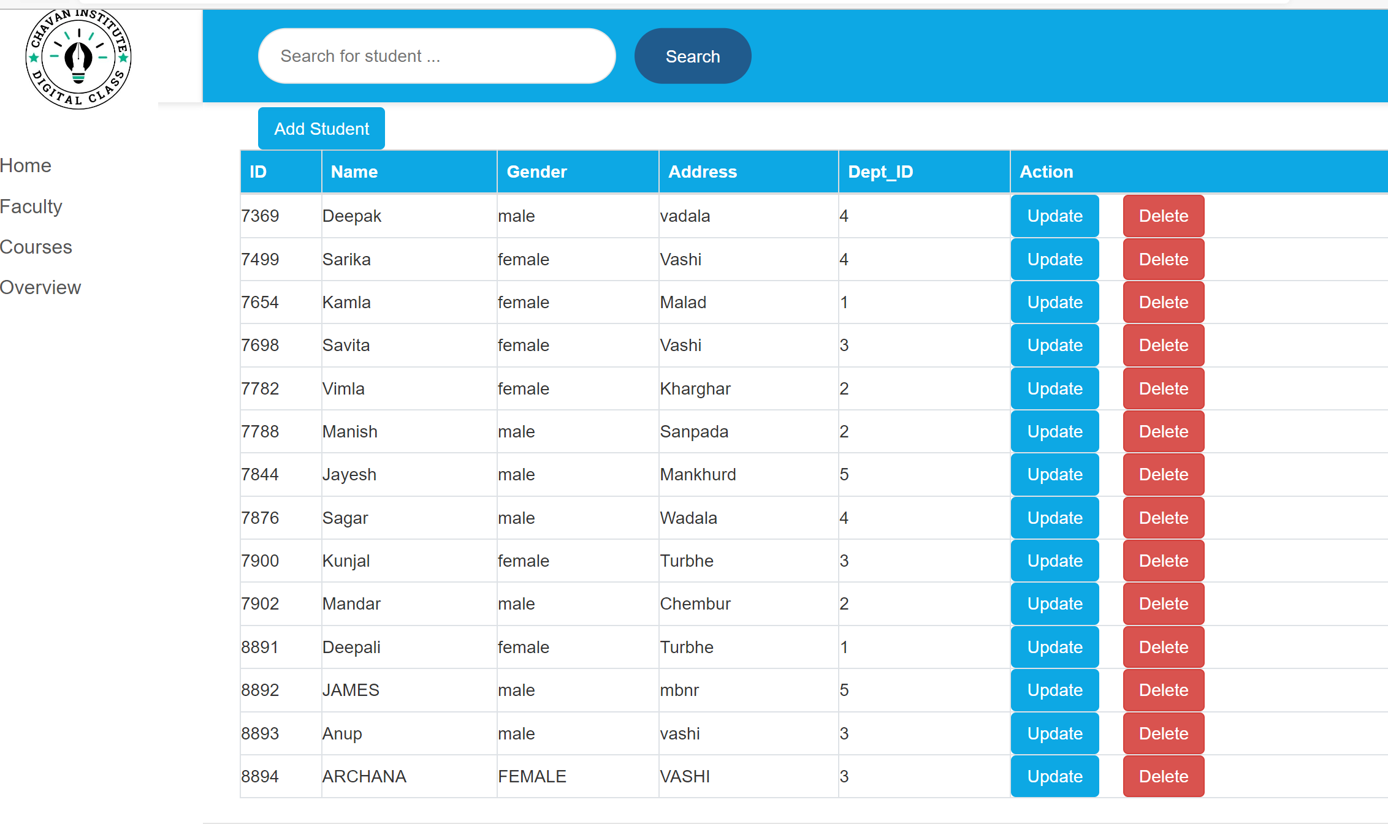
AFTER ADDING

Slide 8
CRUD OPERATIONS:
RETRIVE(VIEW DATA)

Slide 9
VIEW STUDENT LIST

Slide 10
CRUD OPERATION
UPDATE(UPDATE STUDENT THROUGH ID)

Slide 11
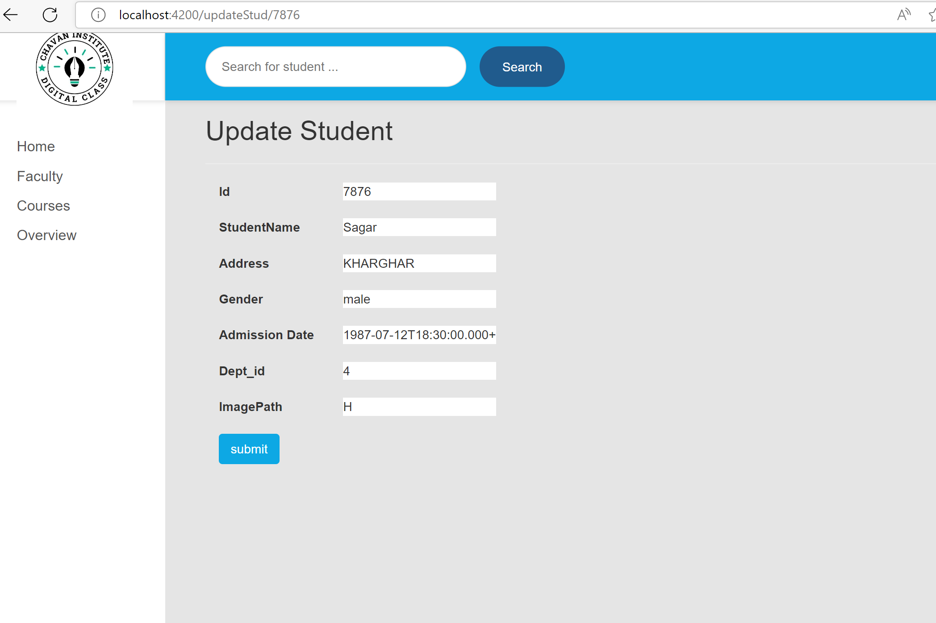
UPDATE STUDENT(FORM)

Slide 12
BEFORE UPDATE(STUDENT DATA)

Slide 13
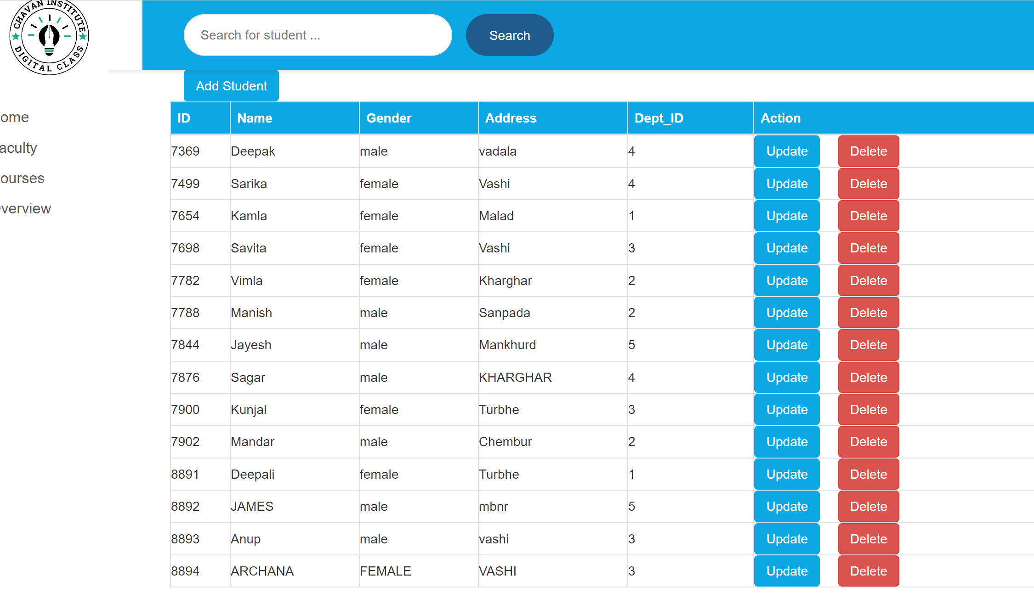
AFTER UPDATE STUDENT(7876 DATA) 7876:Wadala->KHARGHAR

Slide 14
CRUD OPERATIONS
DELETE(DELETE STUDENT DATA)

Slide 15
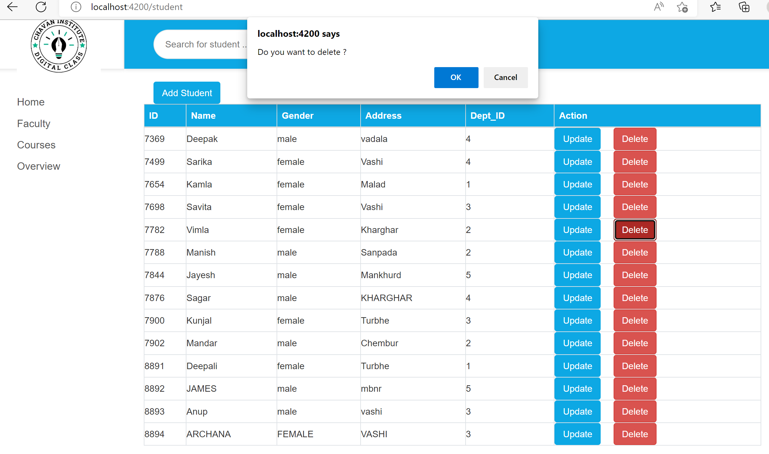
BEFORE DELETE STUDENT DATA

Slide 16
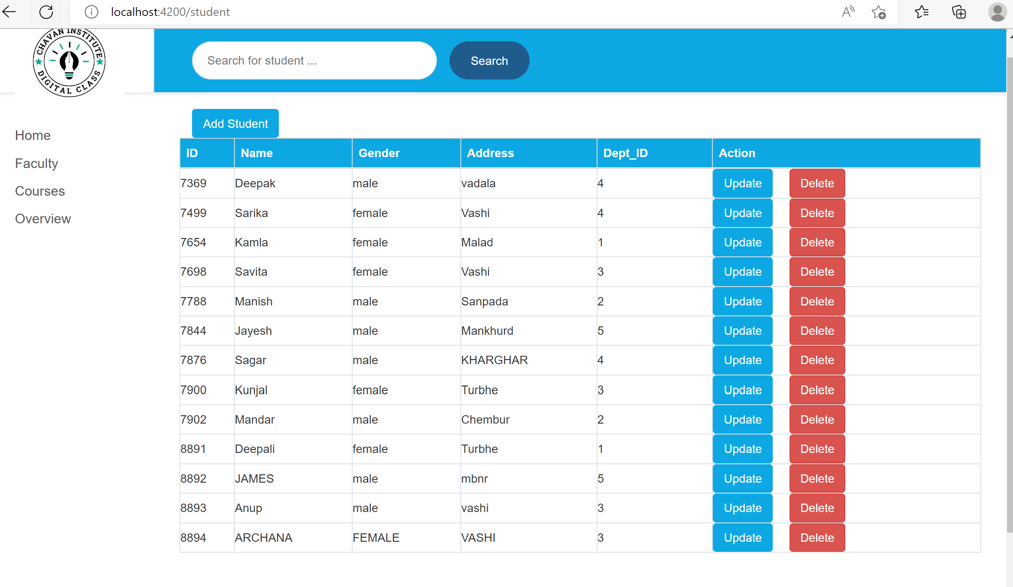
AFTER DELETE (VIMLA DATA)

Slide 17
SEARCH
SEARCH STUDENT DATA THROUGH NAME

Slide 18
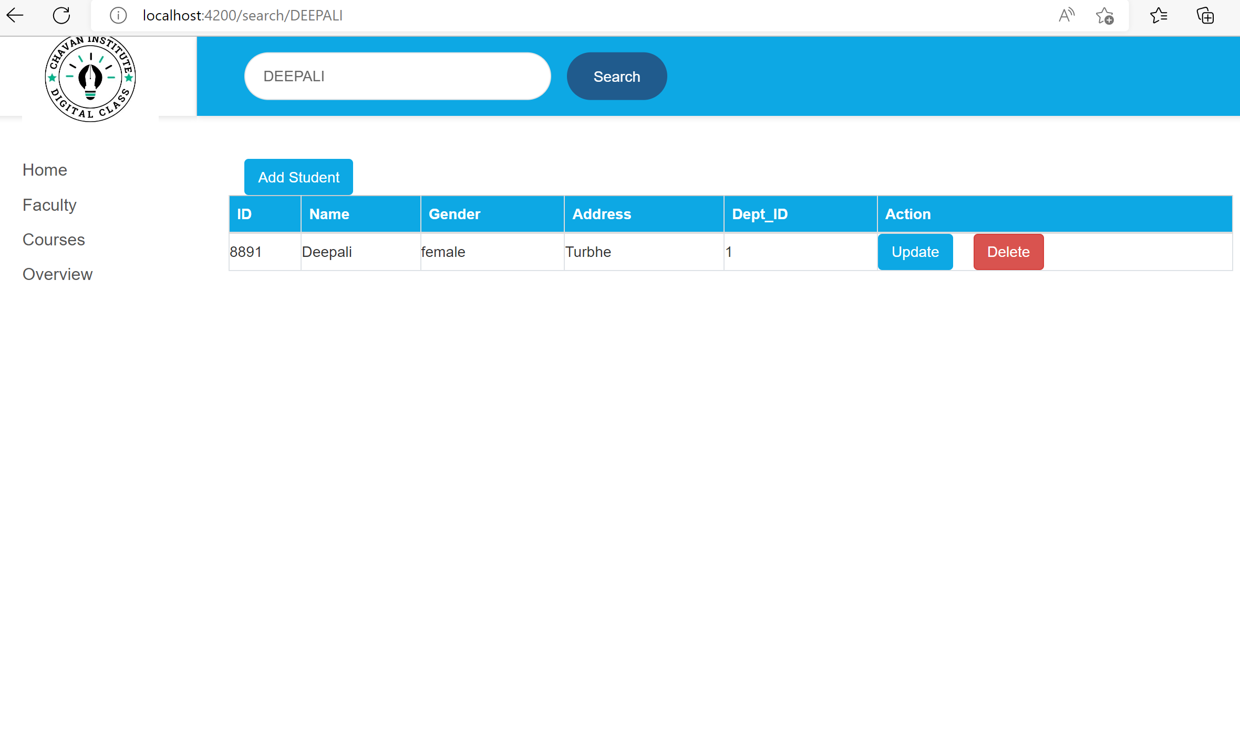
SEARCH

Slide 19
Thank You

